Slide 1
IIS-EHR BiDirectional Query
Technical Background
and
Introduction to Four Focus Areas

Slide 2

Project Goal in Technical Terms
Set a national standard for queries that
  can be supported by most (if not all) IIS
  can be correctly implemented by EHR systems without too much difficulty
  will work well for clinicians
Technical Risks
  Design deficiencies
  Technical flaws
  Partial adoption

Slide 3
Preparation Work: Gap Analysis
Interviewed:
  Work group members
  EHR Vendors
  IIS Vendors
  Clinicians
Talked about:
  Current issues with IIS-EHR interfaces.
  Recommendations for items that need to be standardized.

Slide 4
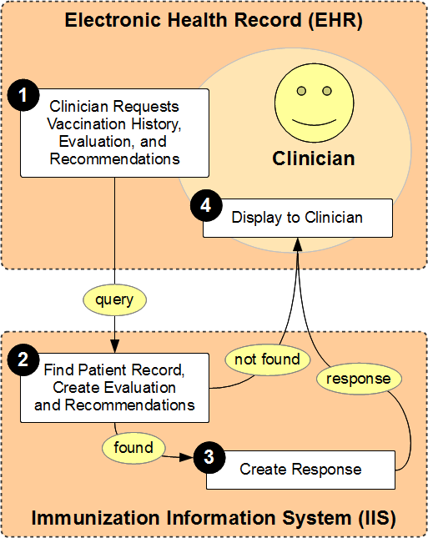
Primary
Use Case
-
Focus for
Work Group

Slide 5
Current Applicable Standards
CDC Implementation Guide
  HL7 v2.5.1 QBP/RSP
Transport Layer Expert Panel (TLEP)
  Common SOAP WSDL

Slide 6
Focus

Slide 7
Not in Scope of Discussion Today
Updates from IIS to the EHR (Outbound VXU's)
Solving problems related solely to EHR submission of immunization data to IIS (VXU).
Vaccine inventory functions and support.
Supporting EHR reminder/recall, population health management, or quality reporting activities.
Integration of EHR with an immunization decision support system (forecaster).

Slide 8
Details on Queries

Slide 9
Basic Types and Modes
Two basic types of interfaces:
  Query: EHR requests a complete record for a single identified patient from the IIS. (In Scope)
  Update: IIS sends a patient record in order to update the EHR. (Out of Scope)
Two basic modes:
  Attended: User initiates and manages process. (In Scope)
  Unattended: EHR or IIS manages process without user control. (To Be Determined)

Slide 10
Vaccination Record
Includes:
  Patient information (demographics)
  Vaccination history (shot record)
  Evaluation and recommendations (forecast)
Formats:
  HL7 v2.3.1 VXR (in response to VXQ) - Not in Scope - original query standard
  HL7 v2.5.1 RSP (in response to QBP) - In Scope
  HL7 v2.* VXU - Not in Scope
  Other non-standard format such as HTML

Slide 11
Patient Identification
IIS return matches based on:
  IIS patient id (unique id assigned by IIS)
  EHR patient id (unique id assigned by EHR)
  Other patient demographic information
Handling possible matches:
  IIS may return no match
  IIS may return list of potential matches
  EHR may allow user to select from potential matches

Slide 12
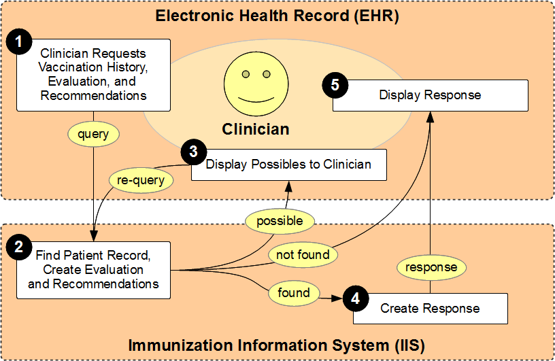
Complete Query Process

Slide 13
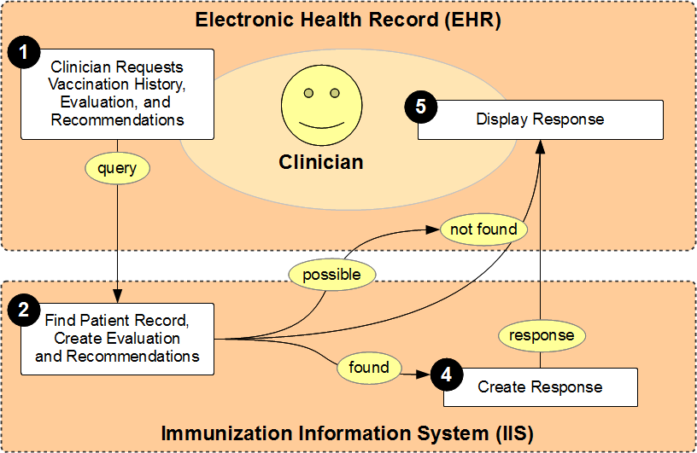
EHR Ignores Possible Matches

Slide 14
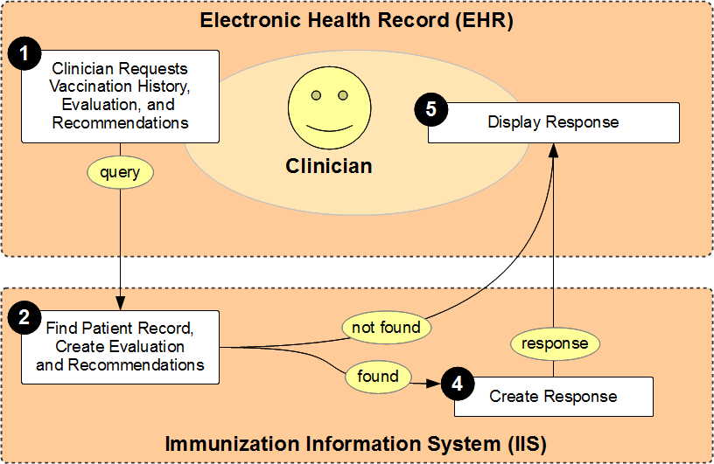
IIS Does Not Return
Possible Matches

Slide 15
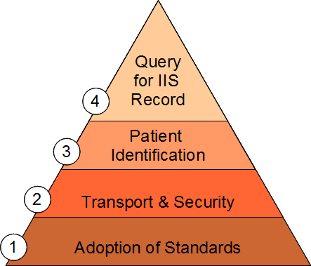
Identified Four Focus Areas

Slide 16
Focus Group Assignment
Review background material
Identify all the decision points
Create a ten minute presentation - due by the end of today
Make group recommendations
Identify next steps

Slide 17
Background Material
Created four word documents with background material, one for every focus area.
Purpose for background material:
  Summarize, document and organize information collected before this meeting.
  Provide base and background information for each focus work group so that work can begin quickly.
Background material will be superseded by artifacts created by work groups.
Text can be lifted from the background material, but do not focus on fixing the original document

Slide 18
Decision Points
Issues that need to be discussed and decided on in order to ensure use case is possible.
Issues that are directly and critically relevant to the primary use case.
Each issue has the potential attributes of:
  Recommended: this needs to be adopted nationally in order for the use case to work
  Permit: not critical for national adoption, but will not harm/distract from national goal
  Discourage: will significantly distract from national adoption of a standard interface

Slide 19
Presentation
Comprehensive
Succinct
10 Minutes Long
Power Point format
  12 to 20 slides for primary presentation
  Additional slides at the end for any other material
  Every slide should have notes with the background information
This presentation is the final deliverable

Slide 20
Recommendations
Making recommendations not decisions
We will document recommendations from:
  Individual work group members
  Focus group recommendations
  Entire work group recommendations
Focus groups need to help determine:
  Decisions that have broad consensus
  Decisions that need more discussion

Slide 21
Next Steps
Focus groups need to recommend next steps that could be taken for specific decisions or recommendations.
Next Steps includes:
  What is the end goal, what is really needed?
  What is the first thing that needs to be done to move towards having this put in place?
  Who in the group can help put the Next Step into place?

Slide 22
Standardization
For a system to support a standard:
  The system MUST support all requirements of standard.
  The system MAY NOT add additional requirements not required by the standard.
  The system MAY support other standards, even local requirements, for other interfaces, as long as it does not affect support and availability of standard interface.

Slide 23
Focus Group Setup
Schedule Today
  Meet before lunch, begin laying out presentation
  After lunch, three rotations to visit other groups
  End of the day, group comes back together and must finish presentation
Team Organization
  Focus group facilitator (already assigned)
  Identify two group presenters
  One presenter must stay and not rotate

Slide 24
Scope
WA
MT
ND
ME
OR
MN
VT
NH
ID
SD
WI
NY
MA
WY
MI
CT
RI
IA
PA
NJ
NV
NE
OH
UT
IL
IN
DE
CO
WV
VA
MD
CA
KS
MO
KY
TN
NC
AZ
OK
AR
SC
NM
MS
AL
GA
TX
LA
FL
AK
HI

Slide 25
Review of Background Documents

